Slide 1
Marketplace Relationships
How Data is Exchanged Between Consumers and Businesses in the DataLucent Data Marketplace

Slide 2
Marketplace Relationships
Overview
B
B
B
A
A
B
B
Data Marketplace
B
Business Client
C
C
C
C
Consumer
C
L
L
C
L
Virtual Licensor
C
L
C
C
C
C
A
Account Manager
C
C

Slide 3
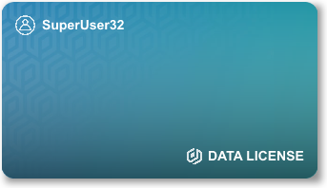


Data Licensing
From the consumer’s viewpoint, each time they approve a license agreement, they will receive a digital license that can be viewed in their profile.
This gives a tangible feeling of ownership to an otherwise abstract and intangible process.
Licensors issue a digital license directly to the user after they consent to a new license agreement.

Slide 4
Licensor/Consumer Relationship
Data Marketplace
Licensors are digital representatives for consumers in the Data Marketplace.
All interactions between the consumer and the Data Marketplace are mediated by the Licensor.
A Licensor helps the user upload, manage, and license their data. They also provide a user-friendly and fun experience.
L
C
C
C
C
Consumer
L
Virtual Licensor

Slide 5
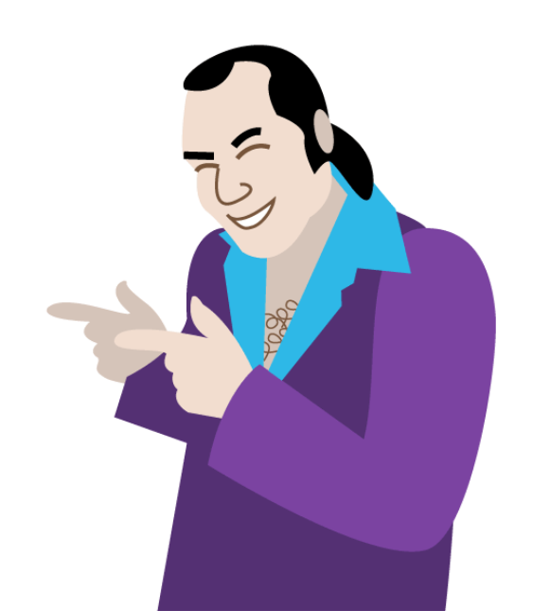


Licensor Customization
The licensor is a digital manifestation of the user’s own data sharing preferences.
After the consumer logs in to DataLucent the app reads some basic information from their profile and assigns them a licensor. This will also assess how comfortable the user is with sharing data and then provide the appropriate walkthroughs and data sharing settings.
The consumer can select a different licensor later if they choose.

Slide 6
Licensor Summary
Data Marketplace
Licensors and digital licenses solve several problems together:
Onboards consumers in a user-friendly way
Makes data more tangible to the consumer
Improves retention through customization and increased engagement
Explains to the consumer how their data is being licensed through the “consumer/licensor/data marketplace” narrative
C

Slide 7
Business/Account Manager Relationship
Account Managers are real life people that are responsible for understanding a client’s needs and finding the appropriate data in the marketplace.
Account Managers are responsible for handling all interactions between the client and the Data Marketplace, as well as any other client needs.
B
B
A
B
Data Marketplace
B
Business Client
A
Account Manager

Slide 8

The Data Exchange
Data Marketplace
Once the data is found, a license agreement is made between the account manager and virtual licensor.
The virtual licensor submits the license agreement to the consumer for approval.
Once approval is given, the license is created. The data is provided to the agent and the reward is provided to the licensor to return to their respective clients.
A
A
A
A
Account Manager
Virtual Licensor

Slide 9
Final Summary
B
B
B
A
A
B
B
The purpose of creating this system is to remove the burden of complexity of exchanging personal data for a reward for both the business client and the consumer.
The structure of the relationship is not without precedent: many marketplaces, such as the stock market, are managed through a broker or agent system.
By applying similar practices to a user-friendly environment, we can reduce the friction in the data exchange process and improve overall customer experience on both ends of the data exchange.
Data Marketplace
A
A
A
C
C
C
C
L
L
C
C
L
C
C
C
C
C
C

Slide 10
Example
Coca-Cola wants a gen-Y panel
DataLucent composes a gen-Y panel of 10k people and presents license agreement to Coca-Cola
Coca-Cola agrees to license deal and provides payment and/or incentive
DataLucent presents license deal to the panelists
Some users will default to accept
We want most users here
Some users will default to ask user
Requires user input and is slow
Some users will default to no
We want to avoid this and with disincentivize it
Users that accept license deal are provided a digital license into their inventory
Reward is distributed to the user via their profile and email

Slide 11
Big Questions
What options do we want to provide to users for data selection?
How do they “opt-out”? By company? By product category?
How do we incentivize people to pick the best sharing options?
What attributes of a profile do we look at to assign a licensor?
What level of human interaction do we provide to consumers?
Chat bot? Forums? Discord server?

